Slide 1
Seminar On Routing and Protocols
By: Asad Hashmi
Sr. Network Engineer
PMAS-ARID Agriculture University
Rawalpindi

Slide 2
Topics to Discuss
Purpose of Router
Classifying Routing Protocols
Static and Dynamic Protocol
Dynamic Protocol
Interior Gateway Routing Protocol (IGRP)
Exterior Gateway Routing Protocol (EGRP)
IG Routing Protocols
Distance Vector (RIPv1, RIPv2)
Link State (OSPF, ISIS)
Configuration setup for Rip (Lab Exercise)
Configuration setup for OSPF (Lab Exercise)
Check Your understanding

Slide 3
Why Router?

Slide 4
Because:
connects two or more packet-switched networks or subnetworks.
To manage traffic between these networks
Allow multiple devices to use the same Internet connection.
forwards data packets between computer networks on bases of best selecting routes
Avoid broadcasting
……..

Slide 5
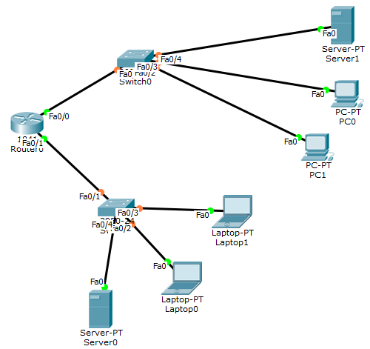
Class A 110.0.0.0/8
What is Router:-
Router Select the port /network to send packet
Class C 192.168.1.0/24
Figure:1 Router and Multiple Networks

Slide 6
How Routers look Physically

Slide 7
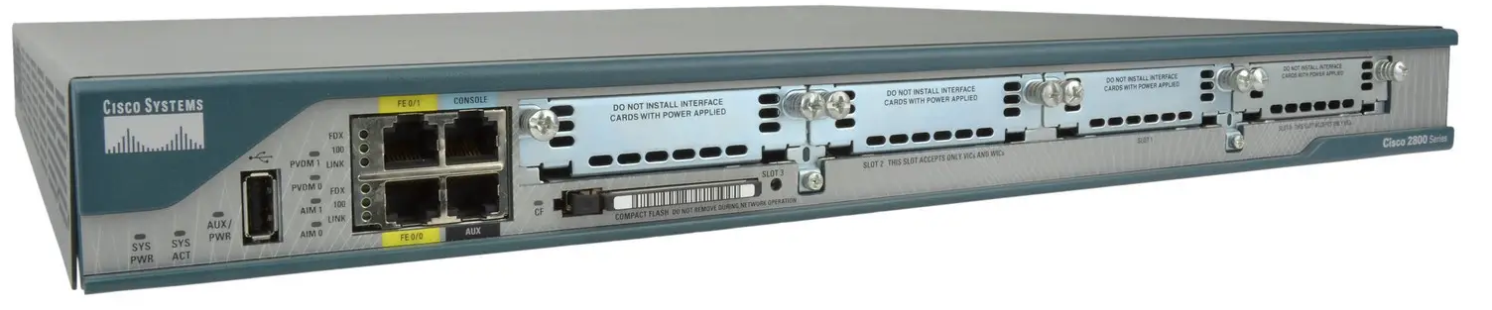
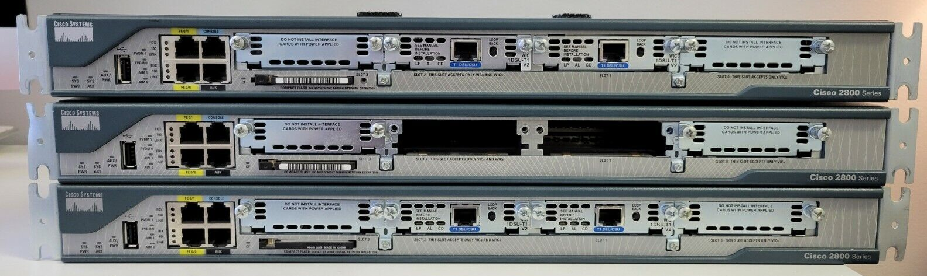
Cisco CISCO2801 Router

Slide 8
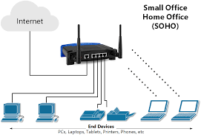
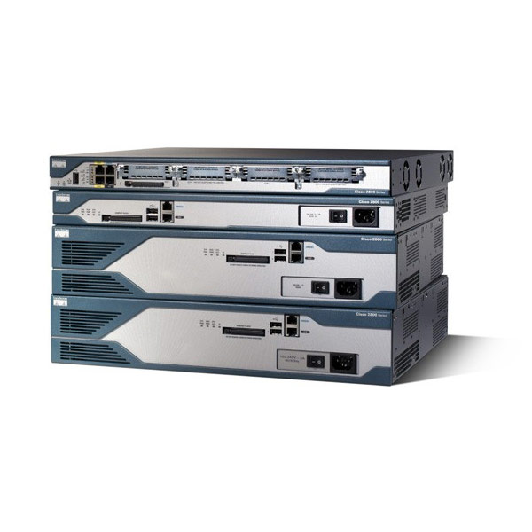

Physical and Icon by Cisco
Small Home and Office use routers
Figure: 2 (a) Physical Cisco Routers 2801
Figure: 2 (b) Cisco Router icon in Packet tracer

Slide 9

Sea Dive to Router

Slide 10
Routing Protocols
Static Protocol
Dynamic Protocols

Slide 11
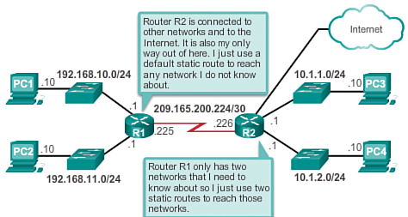
Static Routing
Static
To assign manual routes
For limited Networks
Within Autonomous System
Some times security reason

Slide 12
Example 1: Single Router
Example 2: 2 Router
Example 3: More Then 1 Routers
Hands on Packet Tracer

Slide 13
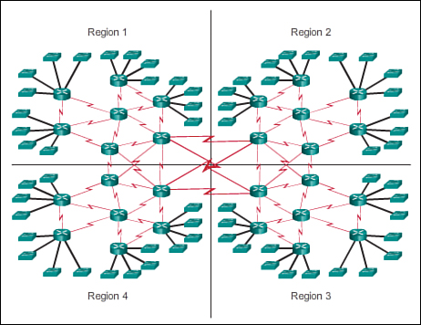
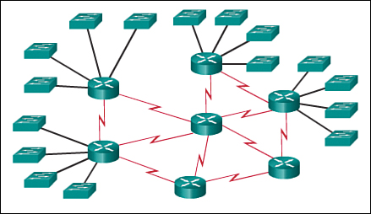
Dynamic Routing
Dynamic
Nabors Discovery
Calculating hopes
Finding best path
Quick response in case of down link
Exchange information
Different autonomous system
Figure-(3) b: Large Network
Figure-3 (a) small network

Slide 14
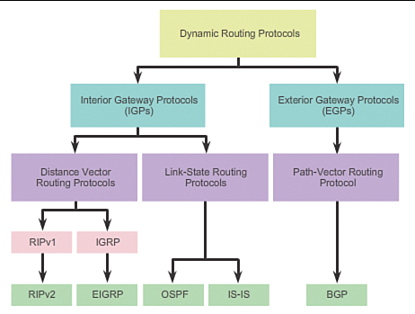
Dynamic Routing Protocol
See Example 1 and 2

Slide 15
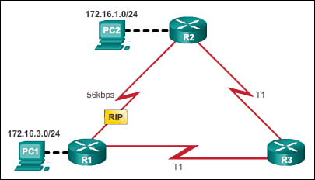
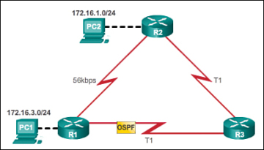
Figure 6 (a): Distance Vector
Figure 6 (b) : Link State
See Example in Packet Tracer

Slide 16
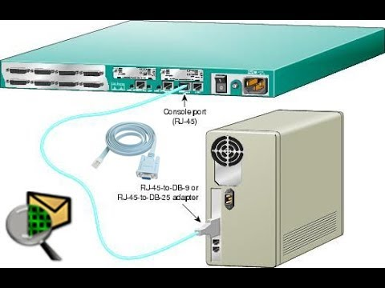
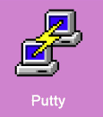
Configuring Router
Requirements:
Console Cable
Router
Putty
PC
In Lab
Packet Tracer 7.1.0 or above version

Slide 17
Basic Routing Configuration
Assigning Passwords
Assigning ip address to interfaces
Configuring protocols according to Network size and scenario

Slide 18
Global configuration mode, using the console port.
Router> (User Mode)
This mode allows the user to execute only the basic commands, such as those that show the system's status.
Router# (Execution Mode)
or privileged mode, is the default mode that a Cisco router is in when it first starts up.
Allows users to view basic information and configuration, but it does not allow for any changes to be made.
Router(config)# (Global Mode)
users to make changes to the router's global configuration settings

Slide 19
Router(config)# show running-configuration
Router(config)# hostname Router-A
Name to change for Router
Router(config)# enable password cisco
To enable password
Configuring Router Interfaces
Router# configure terminal
Router(config)# interface gigabitethernet 0/1
Router(config-if)# ip address 1.1.1.1 255.255.255.0
Router(config-if)# no shutdown
Router(config-if)# exit
Router(config)#

Slide 20
Routing Information Protocol (RIP)
Dynamic routing protocols have been used in networks since the late 1980s.
First routing protocols was Routing Information Protocol (RIP)
RIP version 1 (RIPv1) was released in 1988
However, the newer version of RIP (RIPv2) still does not scale to the larger network implementations of today.

Slide 21
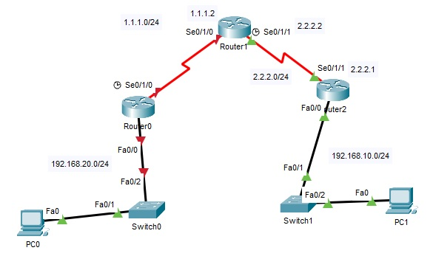
Configuring the RIP Protocol
Figure 7: Network Topology

Slide 22
RIP Configuration
R1# configure terminal
R1(config)# router rip
R1(config-router)# version 2
R1(config-router)# network 192.168.1.0
R1(config-router)# network 1.1.1.0
R1(config-router)#exit
R1(config)#

Slide 23
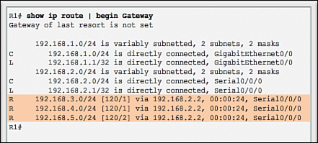

Slide 24
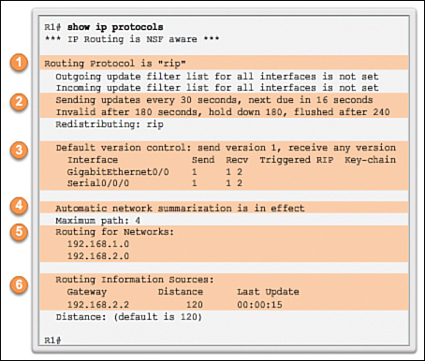

Slide 25
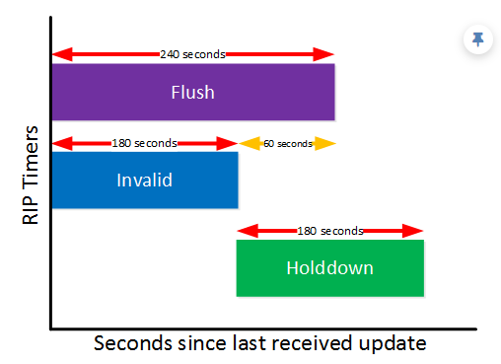

Slide 26
Open Shortest Path First (OSPF)
To address the needs of larger networks, two advanced routing protocols were developed: Open Shortest Path First (OSPF) and Intermediate System-to-Intermediate System (IS-IS)
Cisco developed the Interior Gateway Routing Protocol (IGRP) and Enhanced IGRP (EIGRP)
The OSPF (Open Shortest Path First) protocol is one of a family of IP Routing protocols, and is an Interior Gateway Protocol (IGP) for the Internet, used to distribute IP routing information throughout a single Autonomous System (AS) in an IP network.

Slide 27
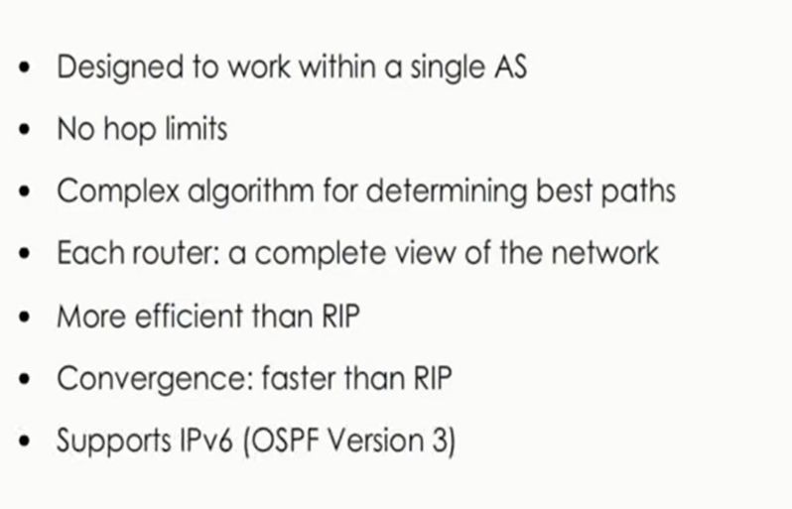
Open Shortest Path First (OSPF)

Slide 28
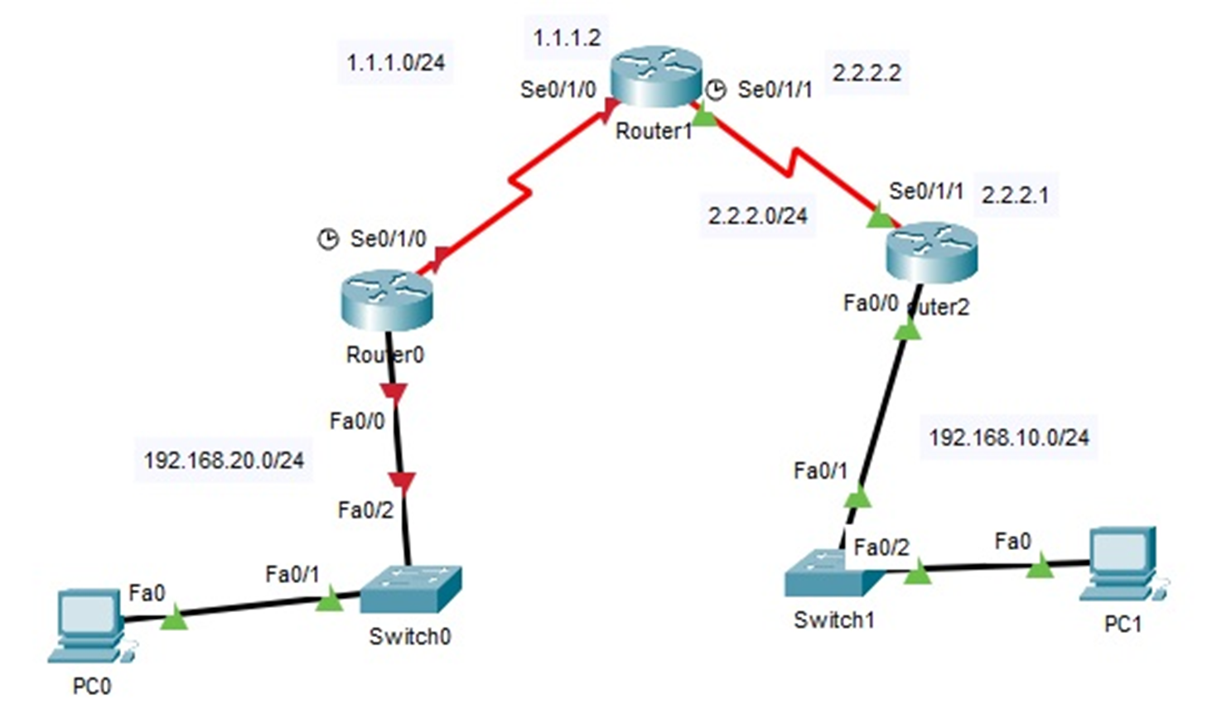
OSPF Configuration

Slide 29
OSPF Configuration
Router-A(config)#router ospf 1
Router-A(config-router)#network 192.168.20.0 0.0.0.255 area 0
Router-A(config-router)#network 1.1.1.0 0.0.0.255 area 0
Router-B(config)#router ospf 1
Router-B(config-router)#network 192.168.10.0 0.0.0.255 area 0
Router-B(config-router)#network 2.2.2.0 0.0.0.255 area 0
R2#show ip protocols
R2#show ip route
R2#clear ip ospf process
R2#show ip ospf neighbor
R2#show ip route ospf
R2#show ip ospf neighbor

Slide 30
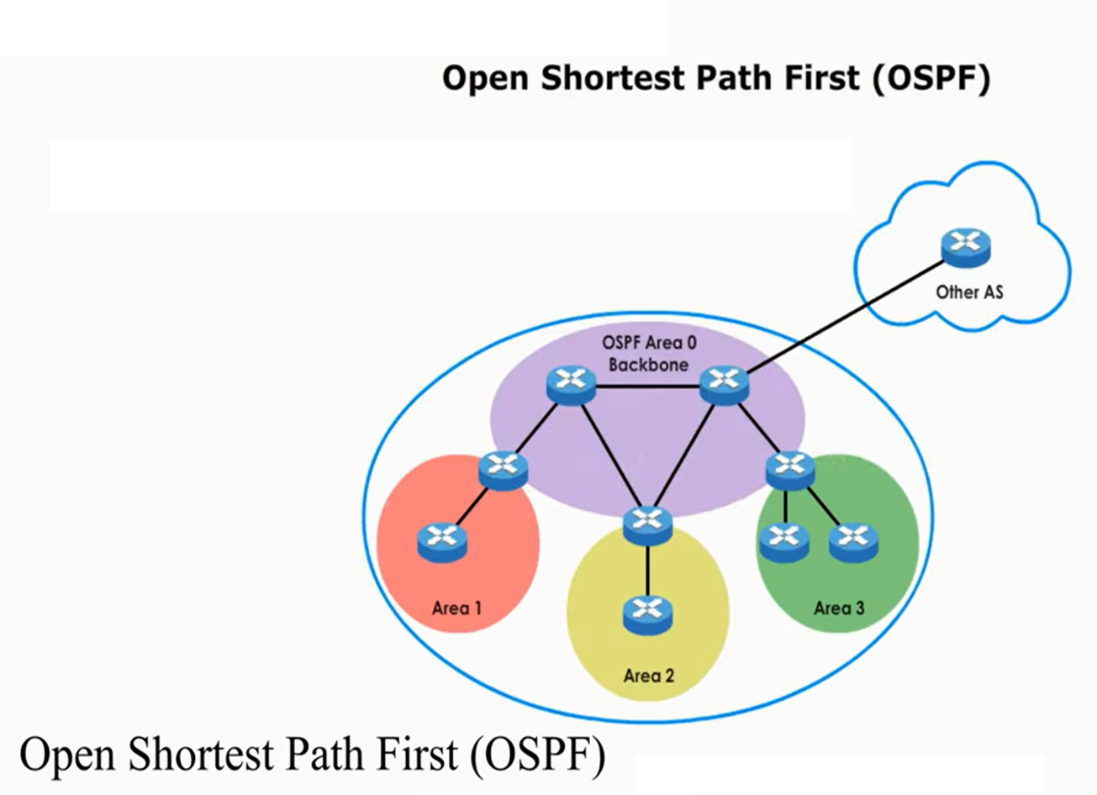

Slide 31
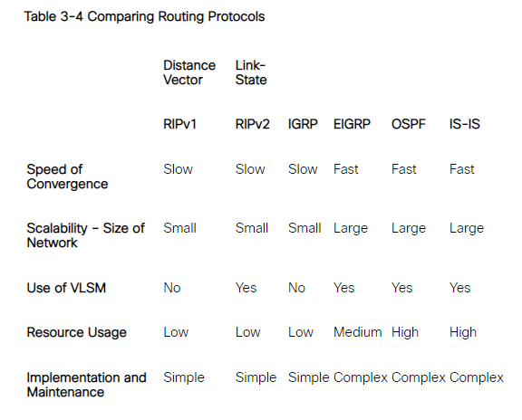
Comparing Routing Protocols

Slide 32
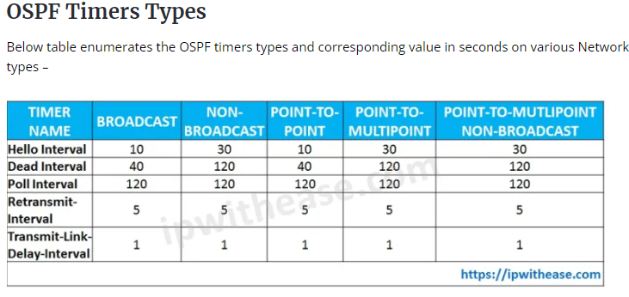

Slide 33
BGP
The Border Gateway Protocol (BGP) is now used between Internet service providers (ISPs). BGP is also used between ISPs and their larger private clients to exchange routing information.

Slide 34
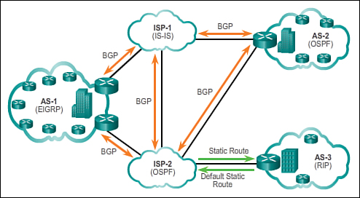
Gateway Protocols
Figure: 4 IGP versus EGP Routing Protocols

Slide 35
Thanks
Question & Answer
Session

